Slide 1



Bi-Weekly Update 4
Team 32: Abhi Singh, Holden Haile, Kelton Chesshire Sponsor: Eric Lloyd Robles TA: Eric Lloyd Robles
Notes:
Michelle

Slide 2
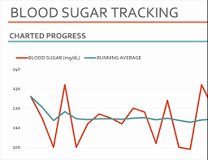
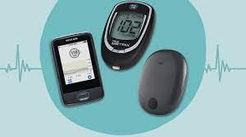
Problem Statement
In the U.S. Alone over 10% of the population suffers from Diabetes.
Type 1 diabetes requires monitoring of blood sugar levels 4-10 times a day.
The process can become a guess and check game with inconsistent data and little comfort for the user

Slide 3
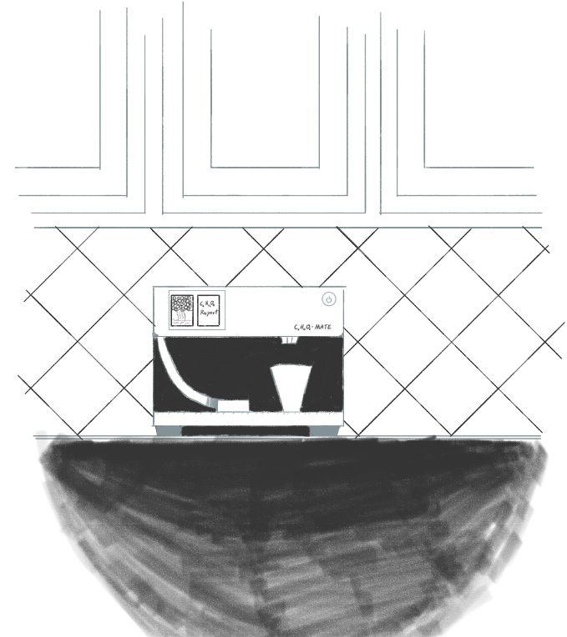
Solution Proposal
Dispense carbohydrates in a consistent, accurate, and easily-consumable manner.
Provide the user with information regarding their personal blood sugar patterns.

Slide 4
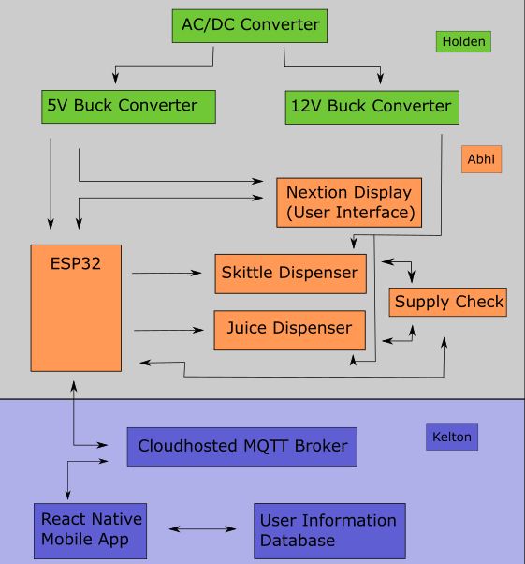
System Overview
Power Supply
Dispenser
Application

Slide 5
Subsystem Changes/Improvements since last week
Design Changes proposed to us by Dr. John Lusher and Subsystem Improvements that are being actively implemented
Dispenser:
Breadboarded Entire Dispenser and Validated The System
Started design of the PCB for the Dispenser
Power Supply:
Tested integration with sinusoidal motor and peristaltic pump.
Created rough draft of housing walls in solidworks.
Application:
Glucose Input, Background Tasks, Notifications
New Glucose Data Screen
Notes:
Eric

Slide 6
Project Timeline
Status Update 1
Status Update 2
Status Update 3
Status Update 4
Status Update 5
Discuss System Improvements
Subsystem Improvements
Major Project Design
Final Subsystem Integration
Preparation for Final Presentation & Demo
We focused on how to improve our subsystems from the good baseline from 403
Subsystem Improvements will be made and tested
Design Housing and PCBs for Dispenser, App integration with Health Apps, HMI control implemented
Dispenser and Power Supply will be installed in the housing, testing and validation of System: Dispenser powered with our Power Supply and Tested with Our App
Final Tweaks to subsystems if needed, polishing the product for presentation and testing user experience
Notes:
Eric

Slide 7
Power Supply
Holden Haile
Accomplishments since last presentation 7 hrs of effort | Ongoing progress/problems and plans until the next presentation
Tested integration with sin motor and peristaltic pump Created rough draft of housing in solidworks Switch and Surge protector integrated into power supply | Housing design process / initial 3D print

Slide 8
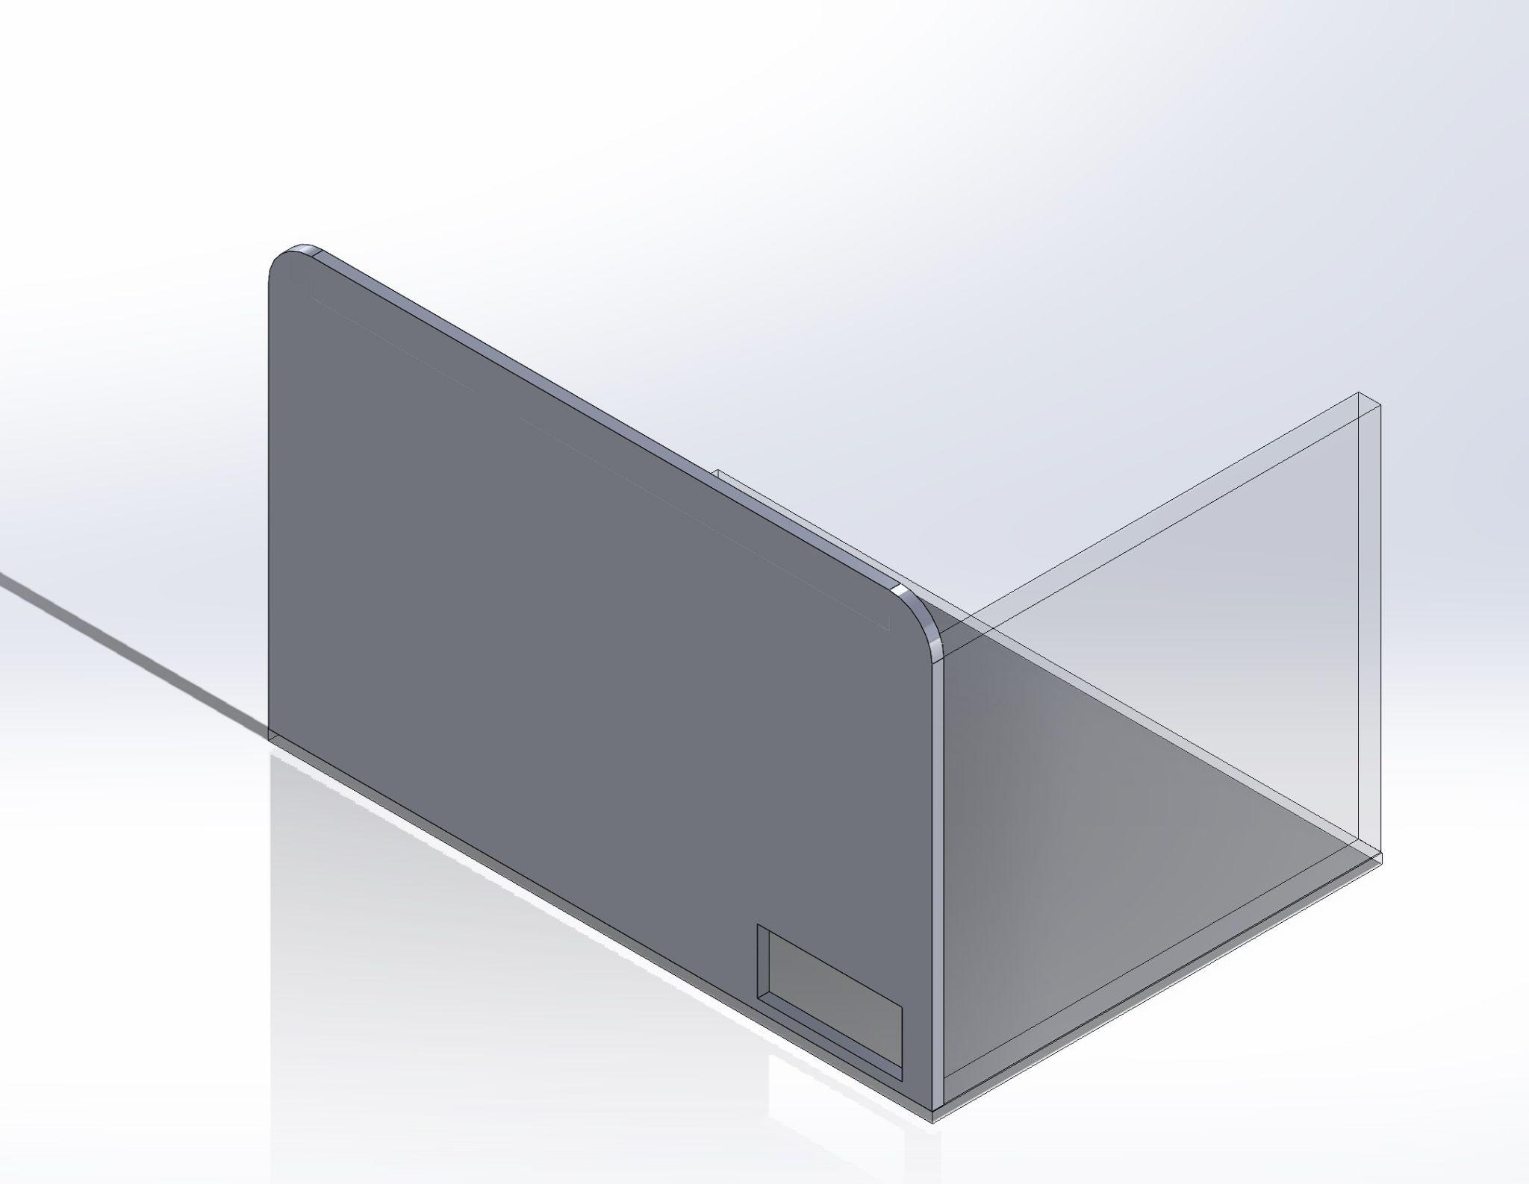
Power Supply
Holden Haile
Housing design in cooperation with Abhi
Housing will hold:
Juice & Skittle Dispensers
Power Supply & Surge Protector
Front Facing Nextion Display
Dispensing Tray

Slide 9
Dispenser
Abhi Singh
Accomplishments since Last Update 7 hrs | Ongoing progress/problems and plans until the next presentation
Breadboarded The Dispenser and Validated the new System Acquired Yellow Badge for FEDC 3D Printer use Ordered clear containers for both the Juice and Skittles Started PCB Design in KiCAD | Design the lid for the juice volume measurer (ultrasonic sensor ** BEHIND ** Design Nextion Display pages for user interface using Kelton’s Canva Designs and test with ESP32 Finish the PCB design and send the gerber files to JLCPCB

Slide 10
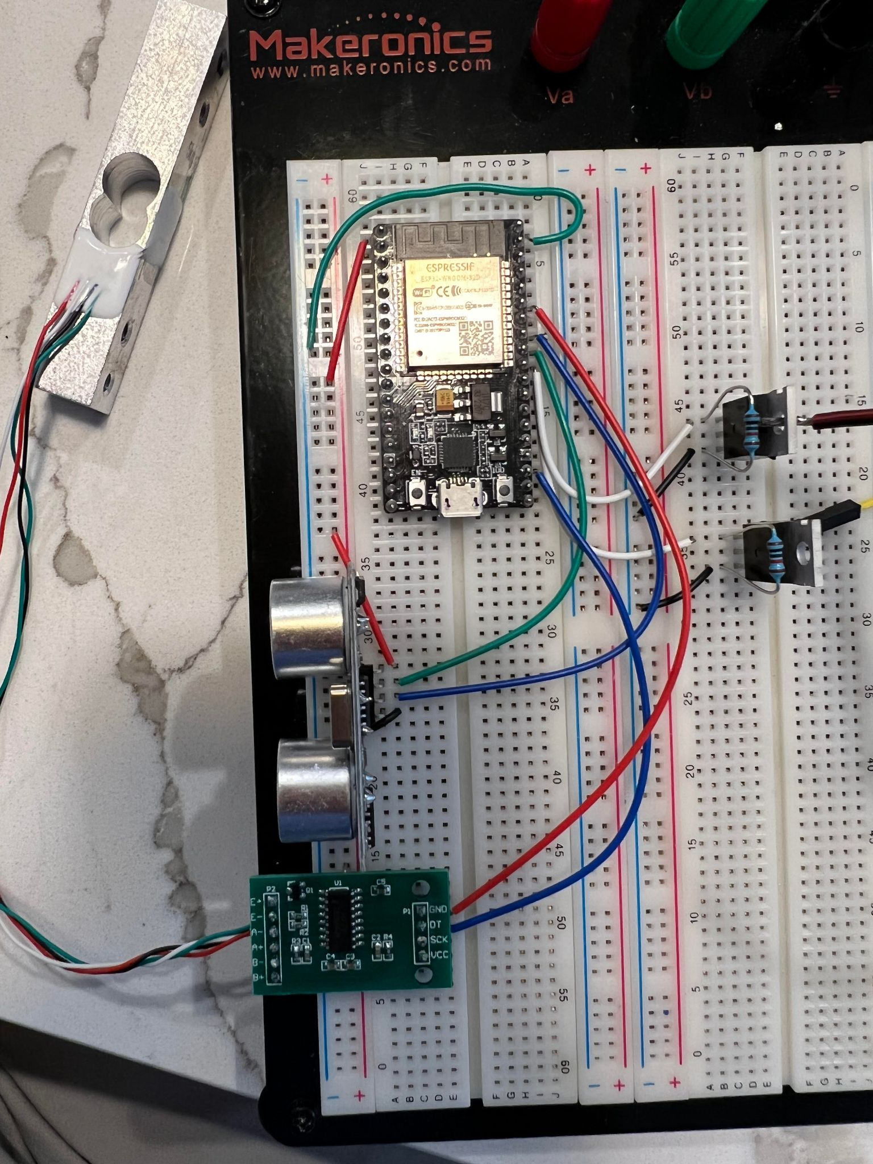
Dispenser
Abhi Singh
Dispenser System works with updated functionality of Sensors
System has been breadboarded and Validated
simple PCB is being designed in KiCAD

Slide 11
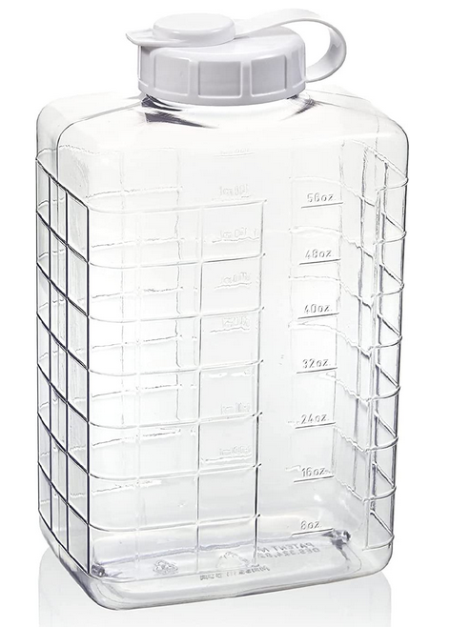
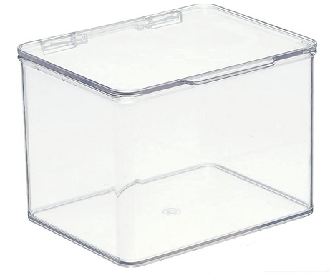
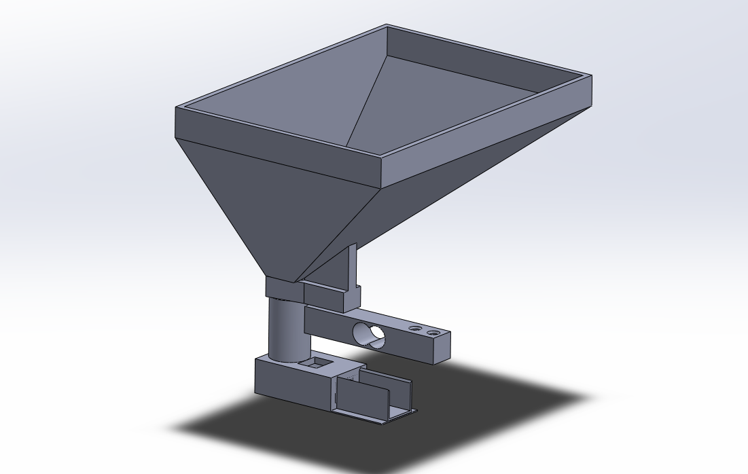

Slide 12
Application
Kelton Chesshire
Accomplishments since Last Update 9 hrs of effort | Ongoing progress/problems and plans until the next presentation
Notifications Background Tasks Glucose Input System Glucose Data Screen | More information screens Nextion Display UI

Slide 13
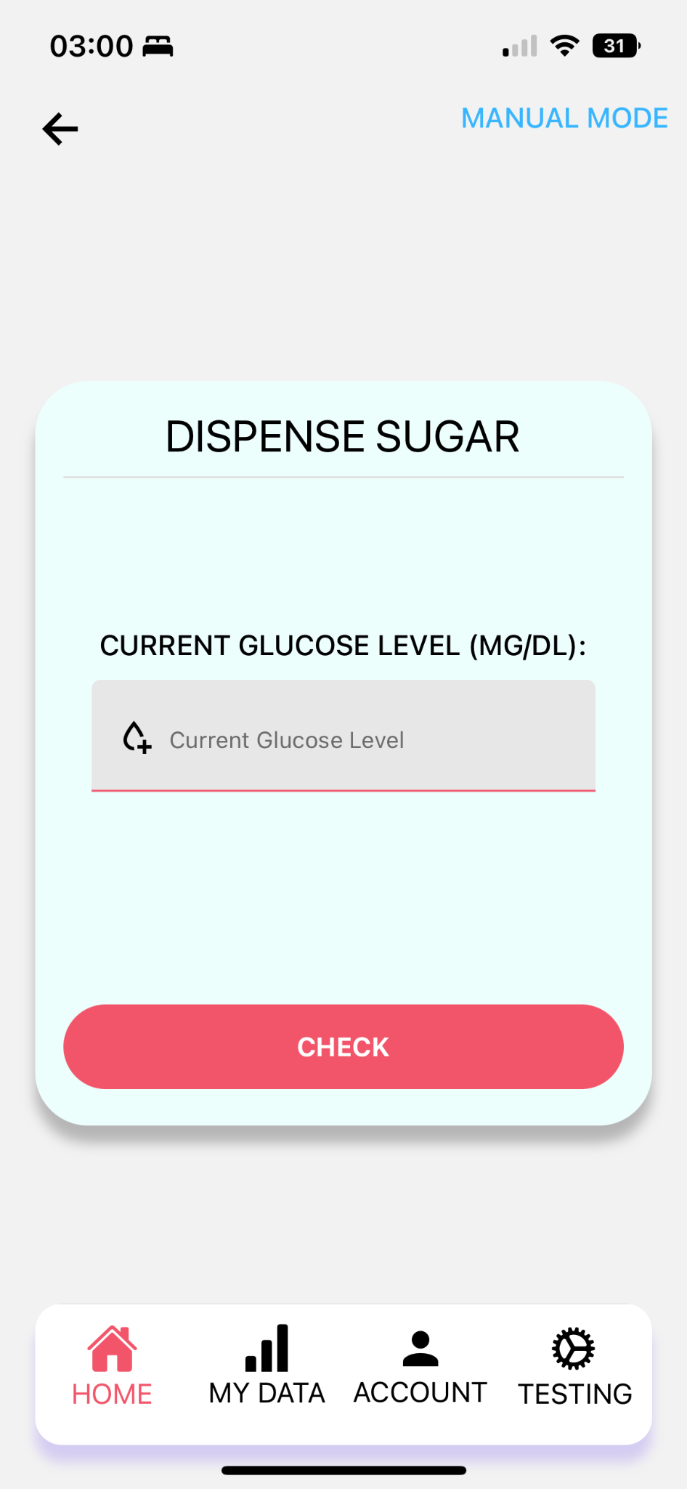
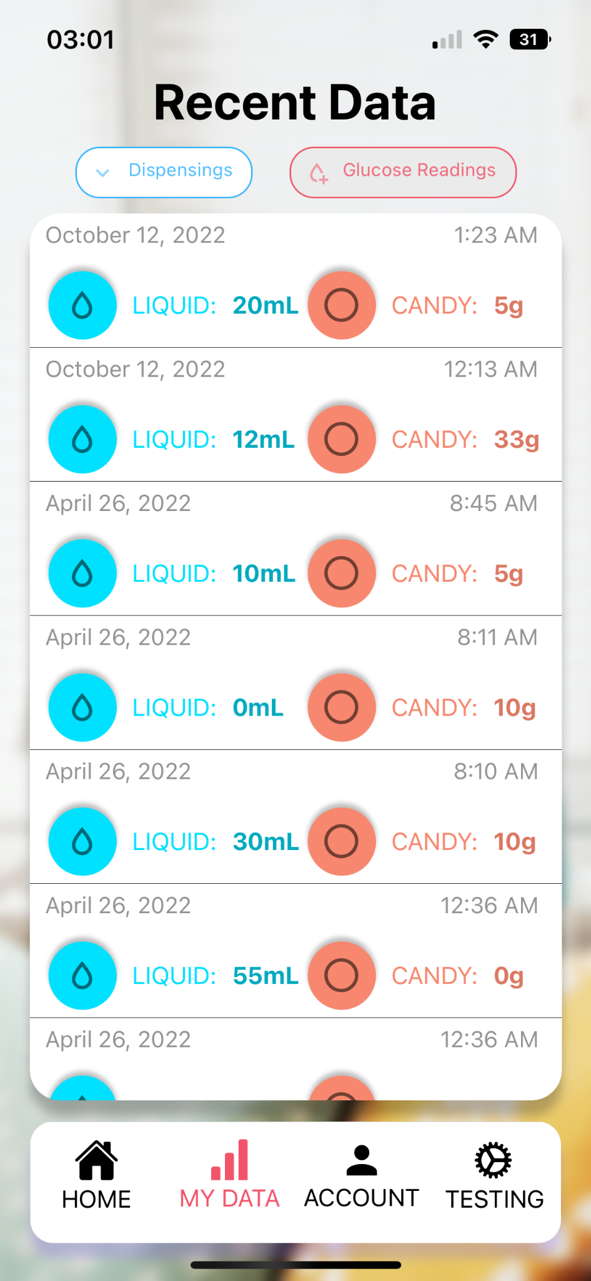
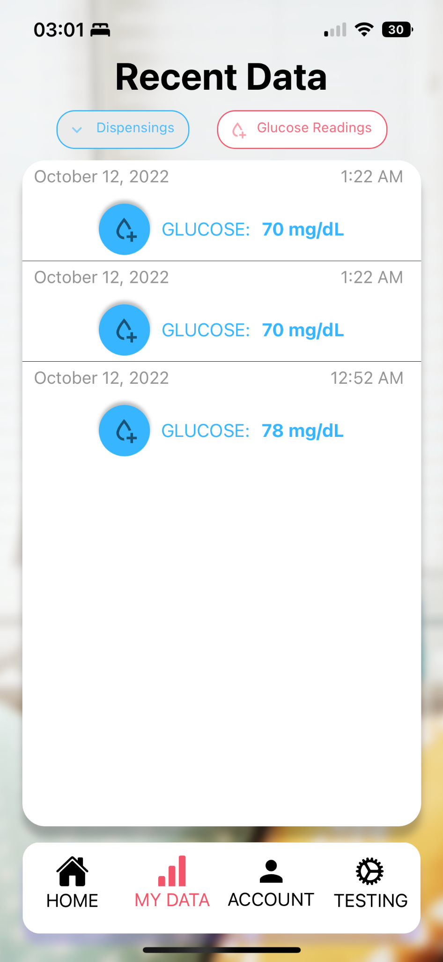
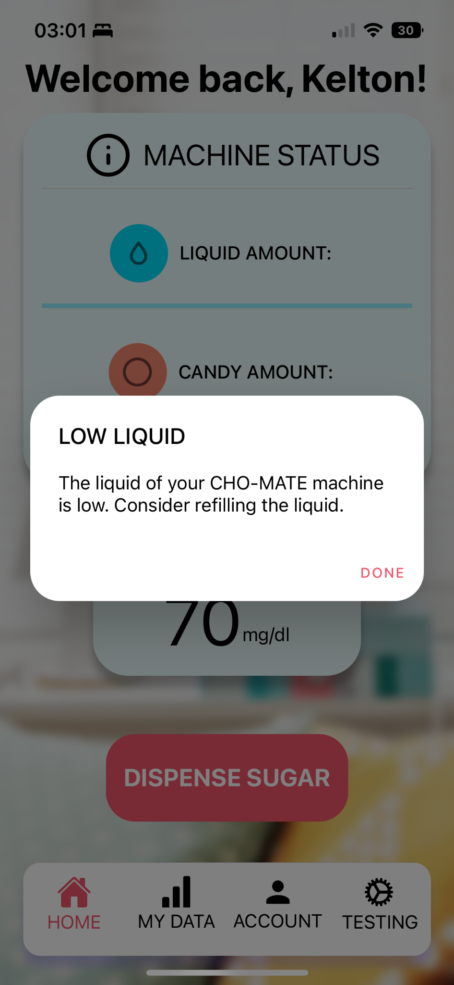

Application
Kelton Chesshire

Slide 14
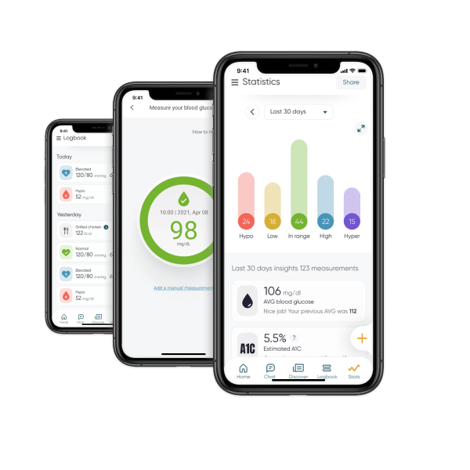
Application
Kelton Chesshire

Slide 15
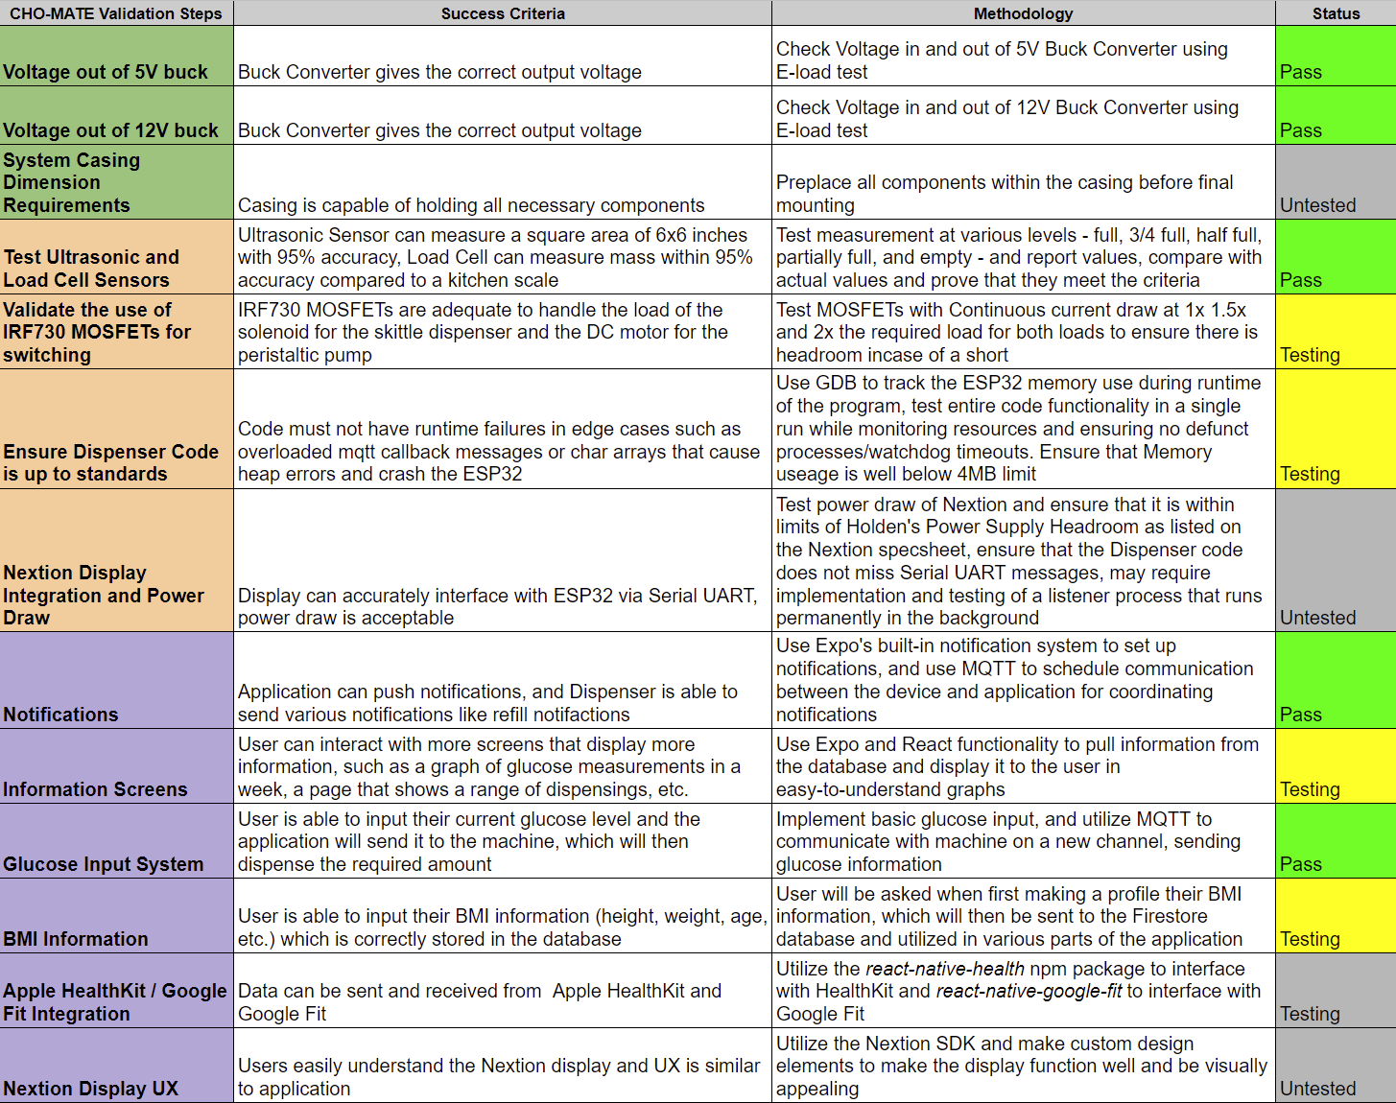
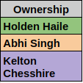
Validation Plan

Slide 16
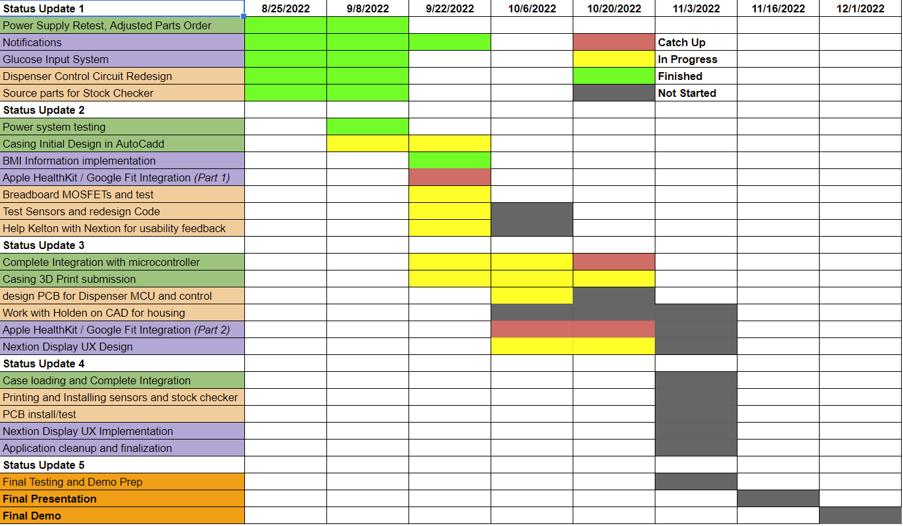
Execution Plan

Slide 17
Questions?

